Slide 1
Multi-AZ Deployments
ow

Slide 2
overview
When you’re architecting highly available and resilient applications on Amazon RDS, it’s important to understand the different types of availability options for your database. Two main configurations in Amazon RDS are Multi-AZ and Cross-Region replication.

Slide 3
RDS Multi-AZ (Multi-Availability Zone) Deployment
What is Multi-AZ?
A Multi-AZ deployment means that Amazon RDS automatically replicates your database to a standby instance in another availability zone within the same region. 🚀
This standby instance is always kept in sync with the primary instance and helps provide automatic failover when needed. If anything goes wrong, RDS automatically shifts your database to the standby instance to minimize downtime and service interruptions.

Slide 4
Key Features :
Synchronous replication between primary and standby instance within the same region 🔄
Automatic failover to the standby instance (in case of failure) 🔄
Great for high availability within the region 🌎
Backup & Maintenance done without disruptions ⏱️

Slide 5
When to Use RDS Multi-AZ?
If you want high availability within a single region 🏙️
When your application needs instant failover to prevent downtime ⏳
Ideal for data durability and automated backups 🗃️
Example: Your E-commerce website 🌐 needs 99.99% uptime and cannot afford downtime during busy sales events like Black Friday. RDS Multi-AZ ensures that your customers can continue shopping and purchasing even if an Availability Zone has an issue!

Slide 6
RDS Cross-Region Deployment
What is Cross-Region?
An RDS Cross-Region Deployment replicates your RDS database to another AWS region, ensuring disaster recovery and global scalability. Unlike Multi-AZ, this option goes beyond a single region and spans across regions. 🌎💼
There are two main methods:
Cross-Region Read Replicas 🏃‍♂️
Cross-Region Snapshot Copying 📸

Slide 7
Key Features
Asynchronous replication (with Read Replicas) between multiple regions 🔄
Geographic data distribution for reduced latency ⏱️ (perfect for international users)
Excellent for disaster recovery 🌪️ (if an entire region goes down)
Ensures business continuity
When to Use RDS Cross-Region? 🤔
If you require disaster recovery or high resiliency across regions 🌏
When your app serves users globally and requires low-latency read access 🌐
For compliance reasons that require data redundancy in a different region 🏛️

Slide 8
..
Example: A global banking application 💳 needs to ensure that data is backed up in multiple regions to meet legal requirements and enhance regional read performance for clients in different continents. RDS Cross-Region deployment ensures data can be read from locations closest to the users, and data is replicated across regions for disaster recovery.

Slide 9
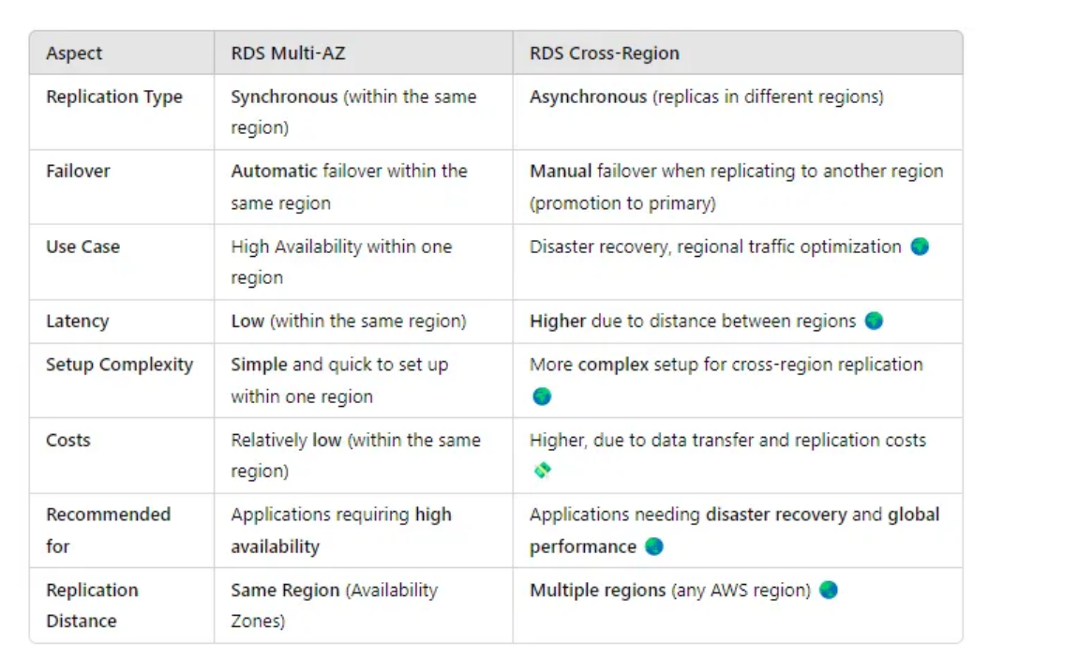
Key Differences Between Multi-AZ and Cross-Region

Slide 10
When to Choose Multi-AZ or Cross-Region: Scenario
Scenario: You have a critical application that can’t afford downtime, and you need availability in case of a zone failure
Use RDS Multi-AZ 🚀 to keep your application running if your availability zone fails.
Scenario: Your company needs to comply with legal/regulatory requirements and replicate data across regions
Use RDS Cross-Region for compliance and disaster recovery that spans global regions

Slide 11
Multi-AZ Setup:
When creating an RDS instance, select Enable Multi-AZ from the console or use CLI to set it up.
AWS automatically manages failover and maintains synchronization between instances without manual intervention.

Slide 12
Cross-Region Setup
Go to RDS, select your instance and click Create Read Replica ✍️
Pick the desired region for the replica.
Enable replication and monitor.

